Slide 1


Mapping Hemochromatosis Genes using a Novel Recessive Diplotype Approach in the Marshfield Clinic Personalized Medicine Research Project (PMRP)
Shicheng Guo
Center for Precision Medicine Research
Marshfield Clinic Research Institute
03/13/2019

Slide 2
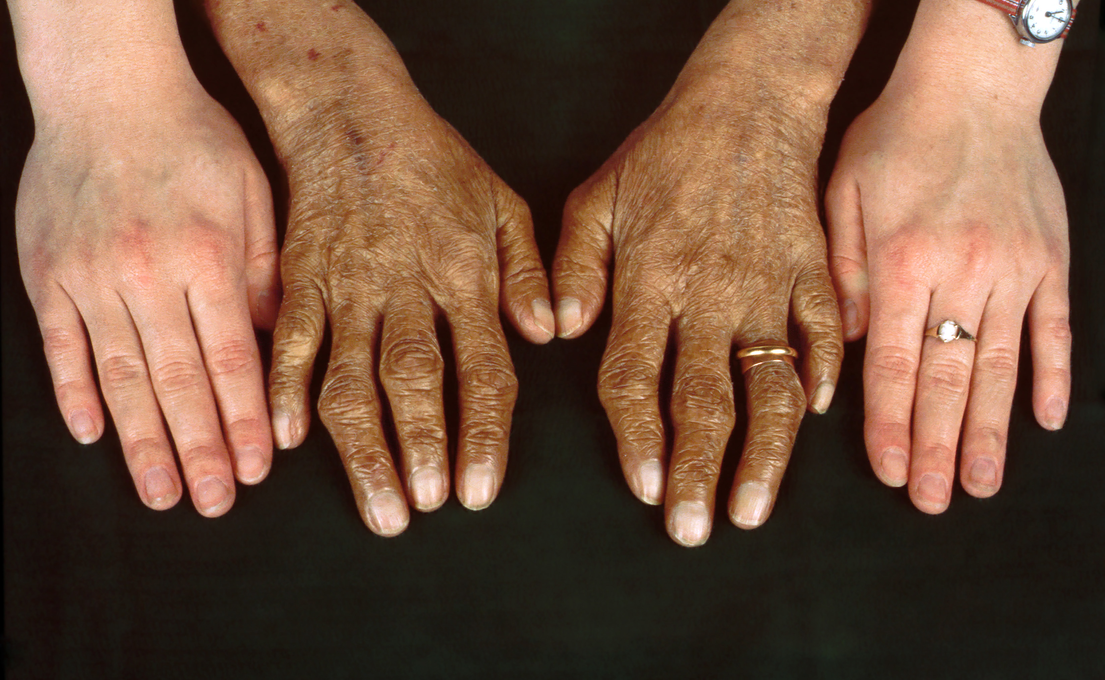
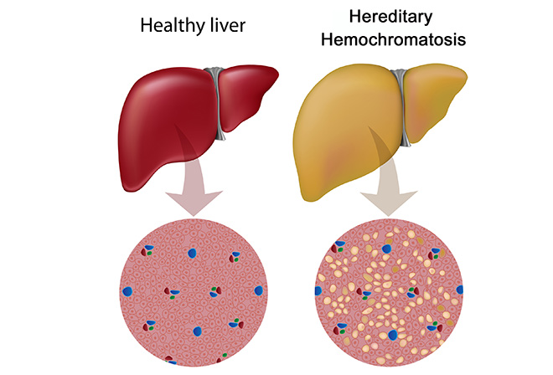
Hemochromatosis: clinical symptoms
Hereditary hemochromatosis (HH) is a genetic disorder characterized by excessive iron accumulation that results in multiple tissues damage
Skin bronzing or hyperpigmentation (70%)
Liver disease (hepatomegaly, 13%; cirrhosis, 13%)
Diabetes mellitus (48%)
Arthropathy
Amenorrhea, impotence, hypogonadism
Grey’s Anatomy: https://www.youtube.com/watch?v=H4SAK7vgfUo
Notes:
Hereditary hemochromatosis is a genetic disorder characterized by excessive iron (Fe) accumulation that results in tissue damage. Manifestations can include systemic symptoms, liver disorders, cardiomyopathy, diabetes, erectile dysfunction, and arthropathy. Diagnosis is by elevated serum ferritin, iron, and transferrin saturation levels and confirmed by a gene assay. Treatment is usually with serial phlebotomies. The most common clinical symptoms are skin bronzing and liver diseases.

Slide 3
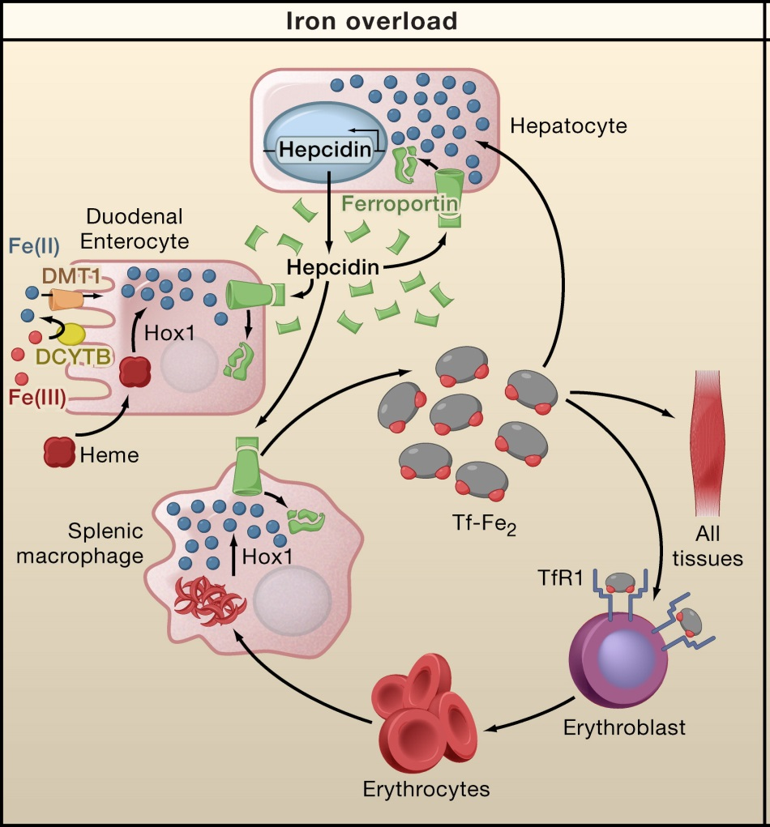
Human iron metabolism and iron homeostasis
Liver cells
Storage and Regulation
HAMP
Intestinal mucosal cells
Iron Absorption
SLC40A1
Blood Cells
Storage and Transport

Slide 4
Genetic etiology of hemochromatosis
 | Type 1 | Type 2A | Type 2B | Type 3 | Type 4
Name | Classic HHC | Juvenile HHC | Juvenile HHC | TfR2-related HHC | Ferroportin-related iron overload
Gene | HFE | HJV | HAMP | TfR2 | SLC40A1
Protein Produced | HFE | Hemojuvelin | Hepcidin | Transferrin receptor 2 | Ferroportin (iron regulatory protein)
Inheritance | autosomal recessive | autosomal recessive | autosomal recessive | autosomal recessive | autosomal dominant
Function | interruption of transferrin-bound iron, possible modulation of hepcidin regulation | unknown; possible hepcidin modulation | regulation of iron release in intestinal and blood cells | possible interference of iron uptake by liver cells | possible interference of iron export from intestinal, liver and placental cells
Organ Damage | variable | high | high | variable | low
Age of Onset | 40s or 50s | 20s or 30s | 20s or 30s | 40s or 50s | 40s or 50s

Slide 5
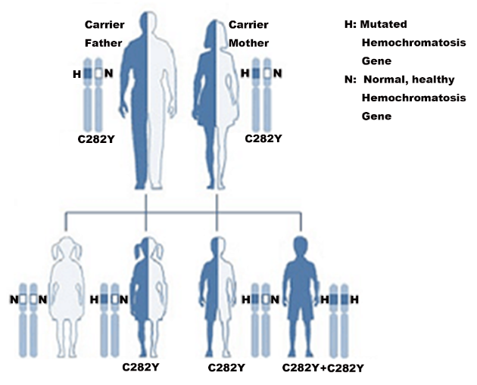
Hereditary hemochromatosis : Recessive Genetic Inheritance
HFE-hemochromatosis/HJV-hemochromatosis
If both parents are carriers of one C282Y mutation in HFE-hemochromatosis gene
25% HH affected, 50% carrier and 25% normal
If one of parents is affected and another one is C282Y mutation carrier.
50% HH affected, 50% carrier
If both parents are affected (both of them have 2 C282Y)
100% HH affected

Slide 6
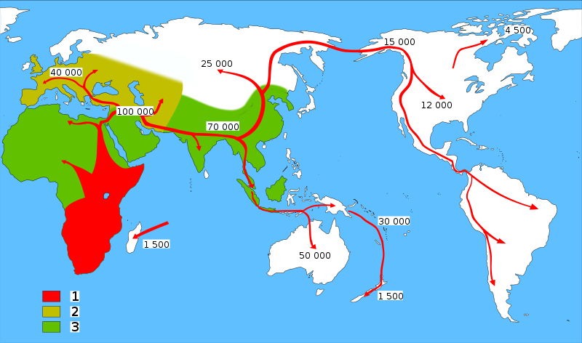
HFE-Hemochromatosis and Human migrations
Neolithic Agricultural Revolution
C282Y ~6000
HFE C282Y, ~6000 years ago
85–90%: Northern European Descent
60%: Mediterranean populations
0% in Asian population
The C282Y allele is the major cause of hemochromatosis as a result of excessive iron absorption. The mutation arose in continental Europe no earlier than 6,000 years ago, coinciding with the arrival of the Neolithic agricultural revolution.
Tsui WM, et al. The C282Y mutation of the HFE gene is not found in Chinese haemochromatotic patients: multicentre retrospective study. Hong Kong Med J 2000;6:153-158.

Slide 7
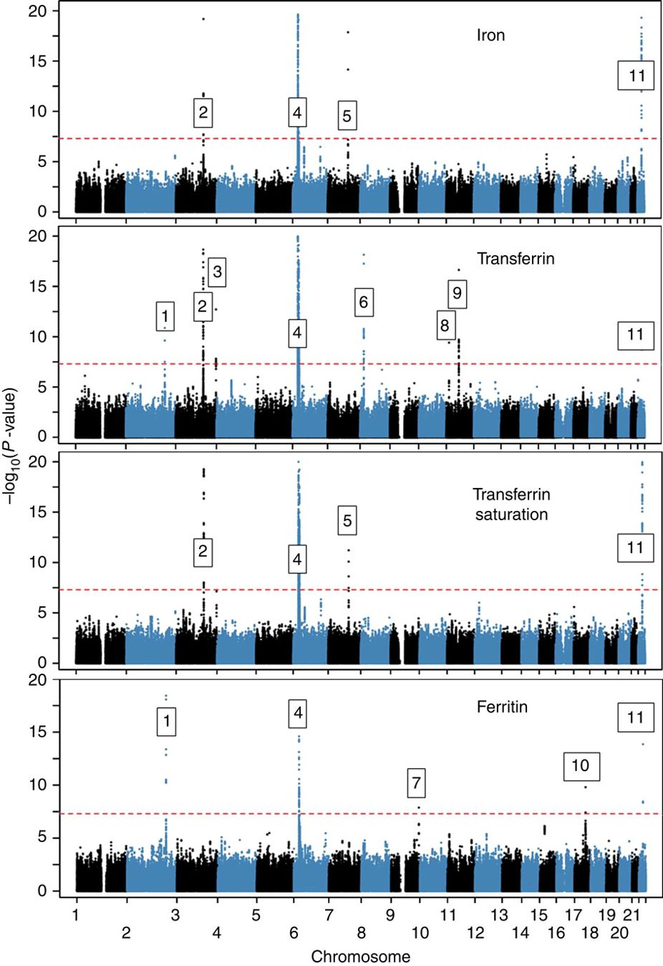
Novel loci affecting iron homeostasis and their effects in individuals at risk for hemochromatosis
HFE, HJV, HAMP, TFR2, SLC40A1
In 2014, Benyamin and colleagues: GWAS
Discovery: 23,986 samples
Validation: 24,986 samples
11 genome-wide-significant (P<5 × 10−8) loci, some including known iron-related genes (HFE, SLC40A1, TF, TFR2, TFRC, TMPRSS6) and others novel (ABO, ARNTL, FADS2, NAT2, TEX14).
Limitation: conventional statistic models
Benyamin B, Esko T, Ried JS, Radhakrishnan A, Vermeulen SH, Traglia M, Gogele M, et al. Novel loci affecting iron homeostasis and their effects in individuals at risk for hemochromatosis. Nat Commun 2014;5:4926.

Slide 8
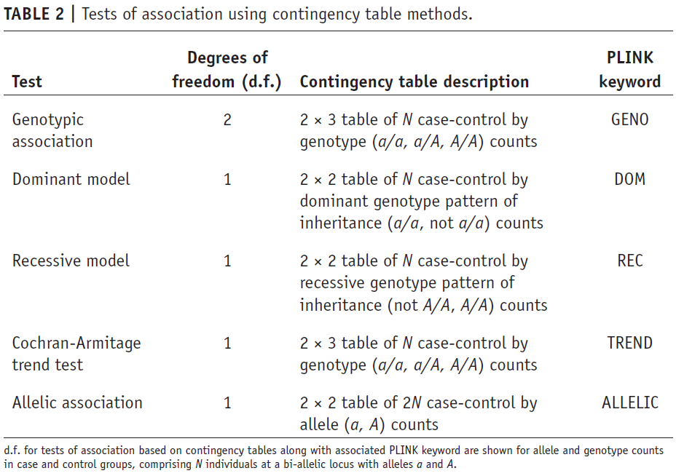
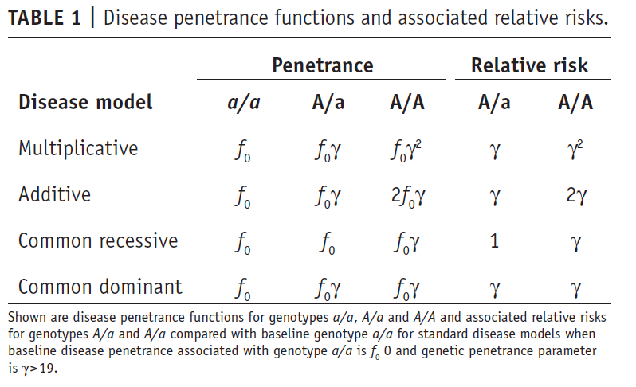
Disease penetrance functions, relative risks and association using contingency table methods
Notes:
As we know there are different disease models for the genetic variants: such as multiplicative, additive, recessive, dominant. Meanwhile, we have different statistic strategy to identify the associated variants for these different disease model.

Slide 9
Exome-wide, Gene-based Recessive Diplotype Scan
Single Site Recessive Effects
Recessive Diplotype
site by site
region by region
Gene-by-Gene Scanning to Identify Disease Genes

Slide 10
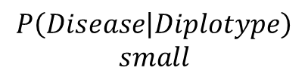
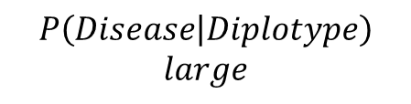
Recessive Diplotype Scan
Power calculations
2-locus model
Gene-based Monte Carlo
using 1000 Genomes
P₁₁
P₁₂
P₂₁
P₂₂
P₁₂ | P₁₂
P₁₁ | P₁₁
P₁₂ | P₂₁
P₁₁ | P₁₂
$$P\left(Disease | Diplotype\right)$$
$$small$$
P₁₂ | P₂₂
$$P\left(Disease | Diplotype\right)$$
$$large$$
P₁₁ | P₂₁
P₂₁ | P₂₁
P₁₁ | P₂₂
P₂₁ | P₂₂
P₂₂ | P₂₂

Slide 11
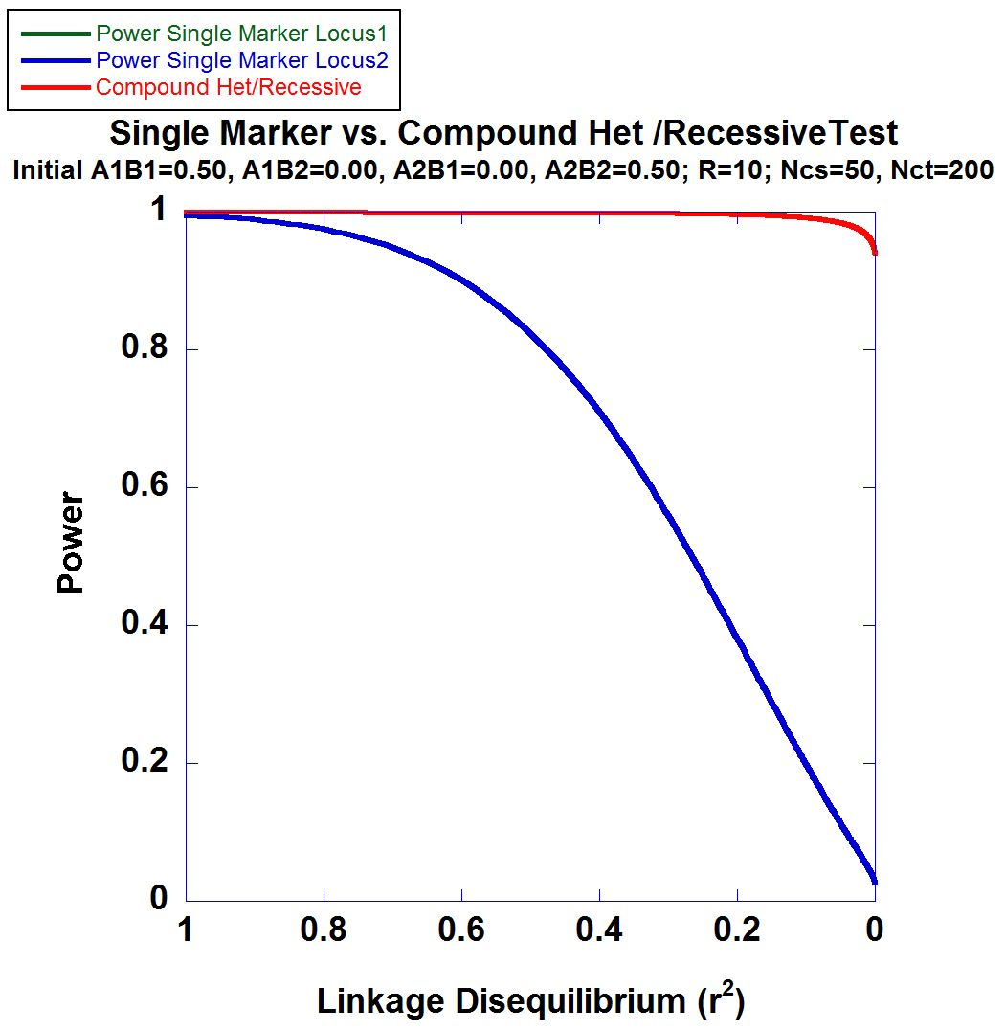
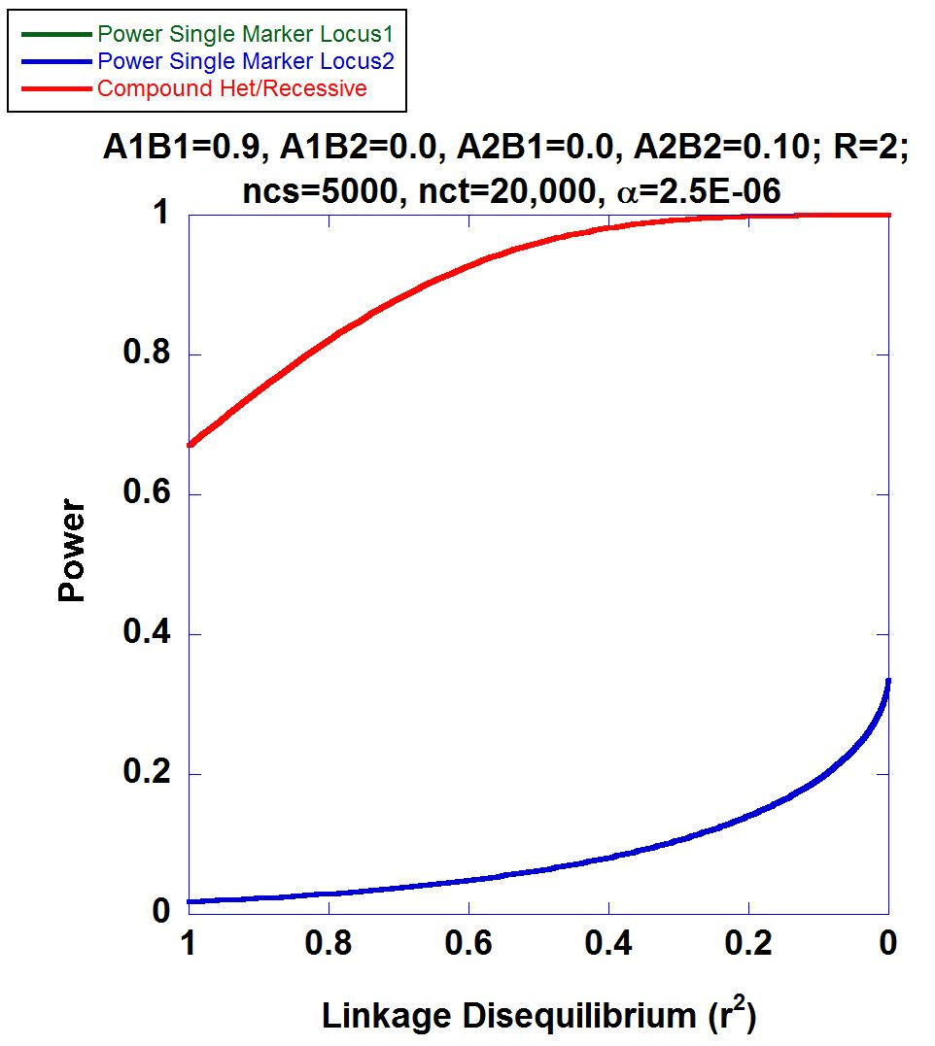
2-locus Power Calculations

Slide 12
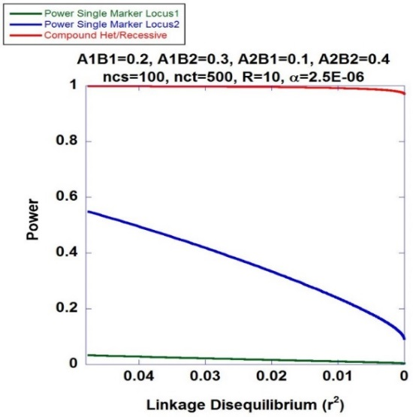
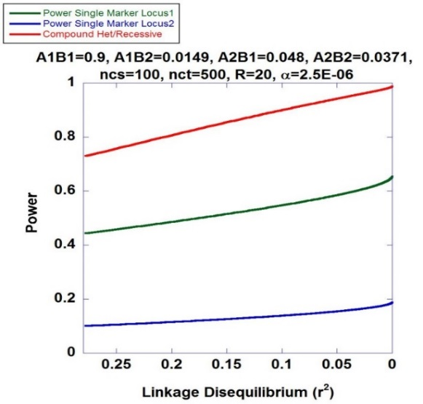
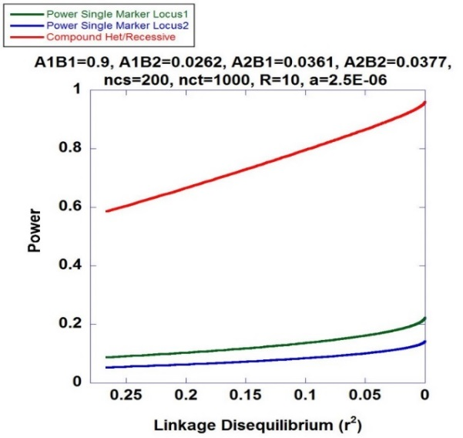
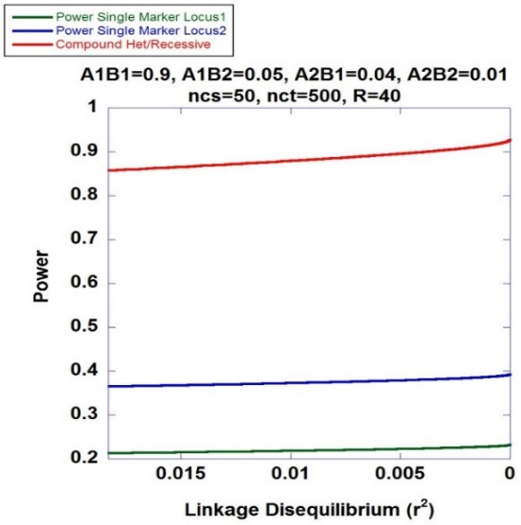
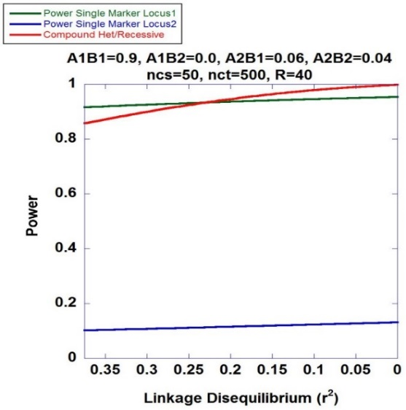
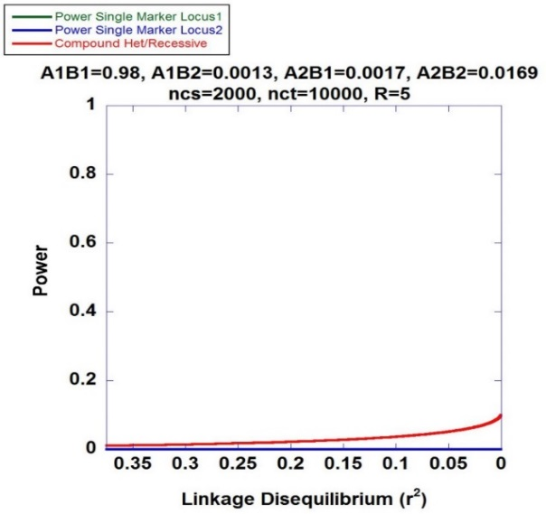
Higher Power of Recessive Diplotype Scan benefits PMRP
Recessive Diplotype approach always has higher power to identify the associated variants

Slide 13
Mapping Hemochromatosis Genes using a Novel Recessive Diplotype approach in PMRP
Exome beadchip data used on 10,000 subjects
PCA used to exclude genetic background outliers
Phasing using localized haplotype clustering
Putative functional variants: GWAS-significant, nonsynonymous, 3’UTR, 5’UTR, or splice site
Two or more in silico pathogenic annotations
ICD9: two or more instances of (i) iron metabolism disorder (ii) hereditary hemochromatosis, (iii) unspecified hemochromatosis
Transferrin saturation (ratio of serum iron to transferrin iron-binding capacity) > 48%
18 cases identified and 6,896 controls

Slide 14
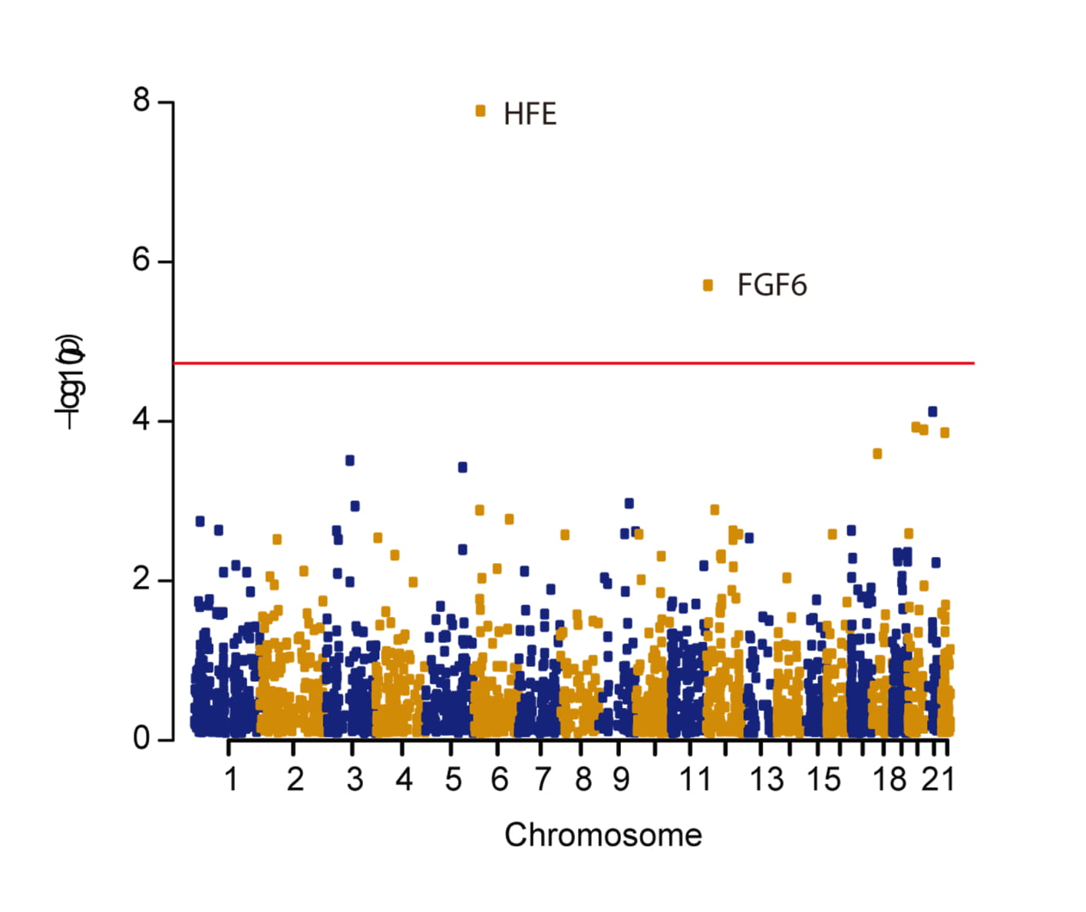
Manhattan Plot
CHR | GENE | P | OR#
chr6 | HFE | 1.29×10⁻⁸ | 28.6
chr12 | FGF6 | 1.99×10⁻⁶ | 22.8
chr21 | KRTAP15-1 | 7.55×10⁻⁵ | 6.78
chr20 | XKR7 | 1.18×10⁻⁴ | 43.6
chr20 | CABLES2 | 1.28×10⁻⁴ | 42.4
chr22 | THOC5 | 1.38×10⁻⁴ | 6.24
KRTAP15-1
XKR7

Slide 15
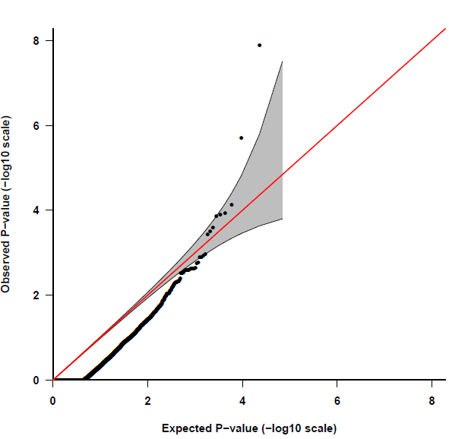
Quantile-Quantile Plot
HFE
FGF6
Fibroblast Growth Factor 6
Heparin-Binding Growth Factor 6
Heparin Secretory-Transforming Protein 2
FGF6
Poli M, Girelli D, et al. Heparin: a potent inhibitor of hepcidin expression in vitro and in vivo. Blood 2011;117:997-1004.

Slide 16
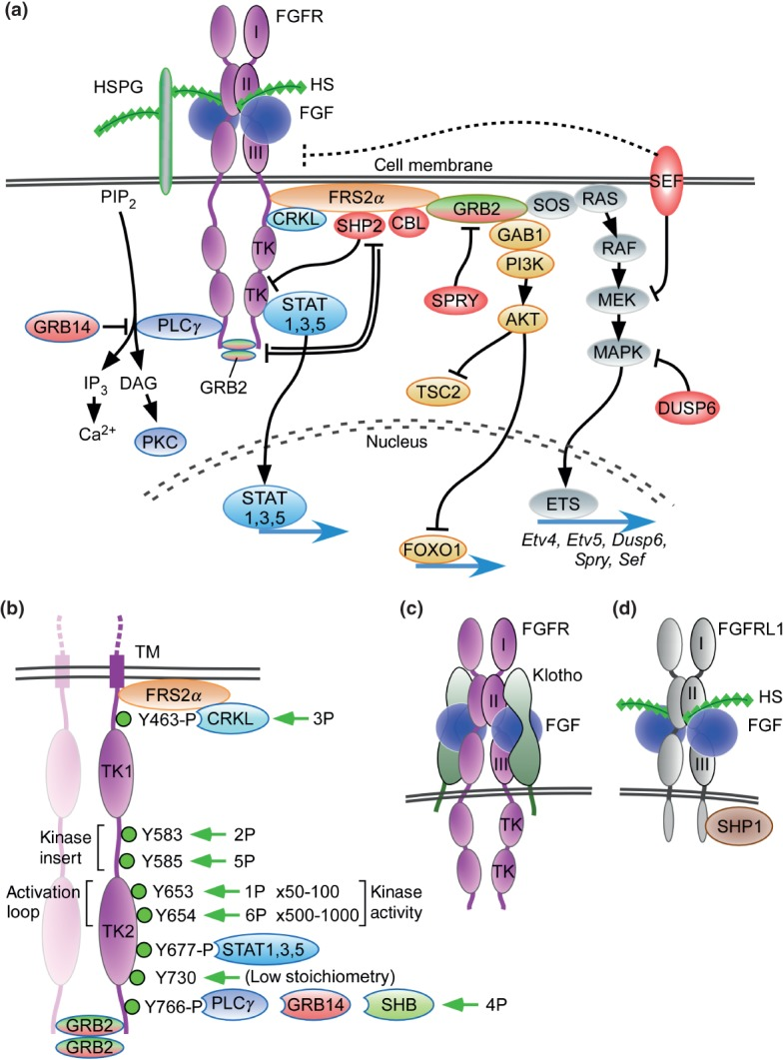
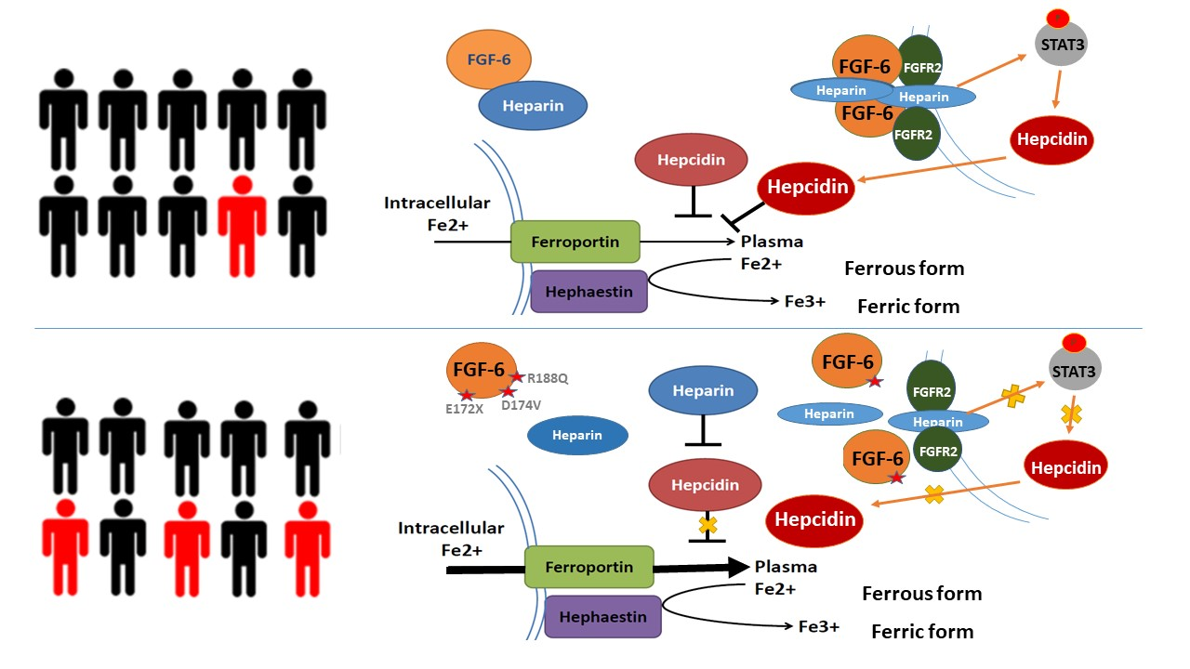
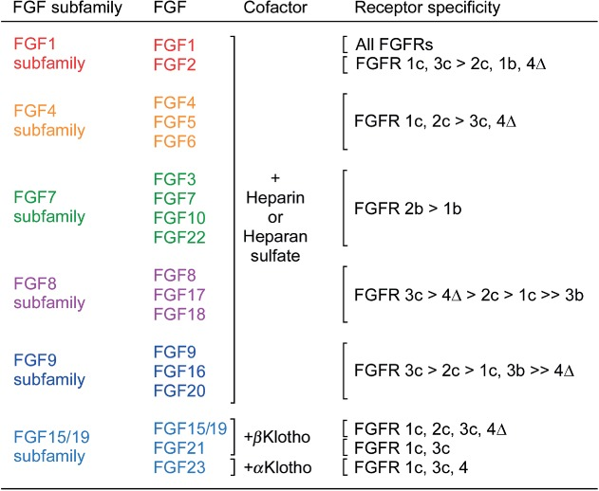
FGF6: gene family and pathway
Hepcidin (HAMP)
Heparin

Slide 17
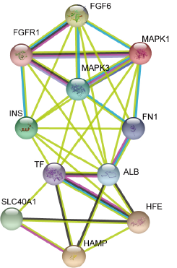
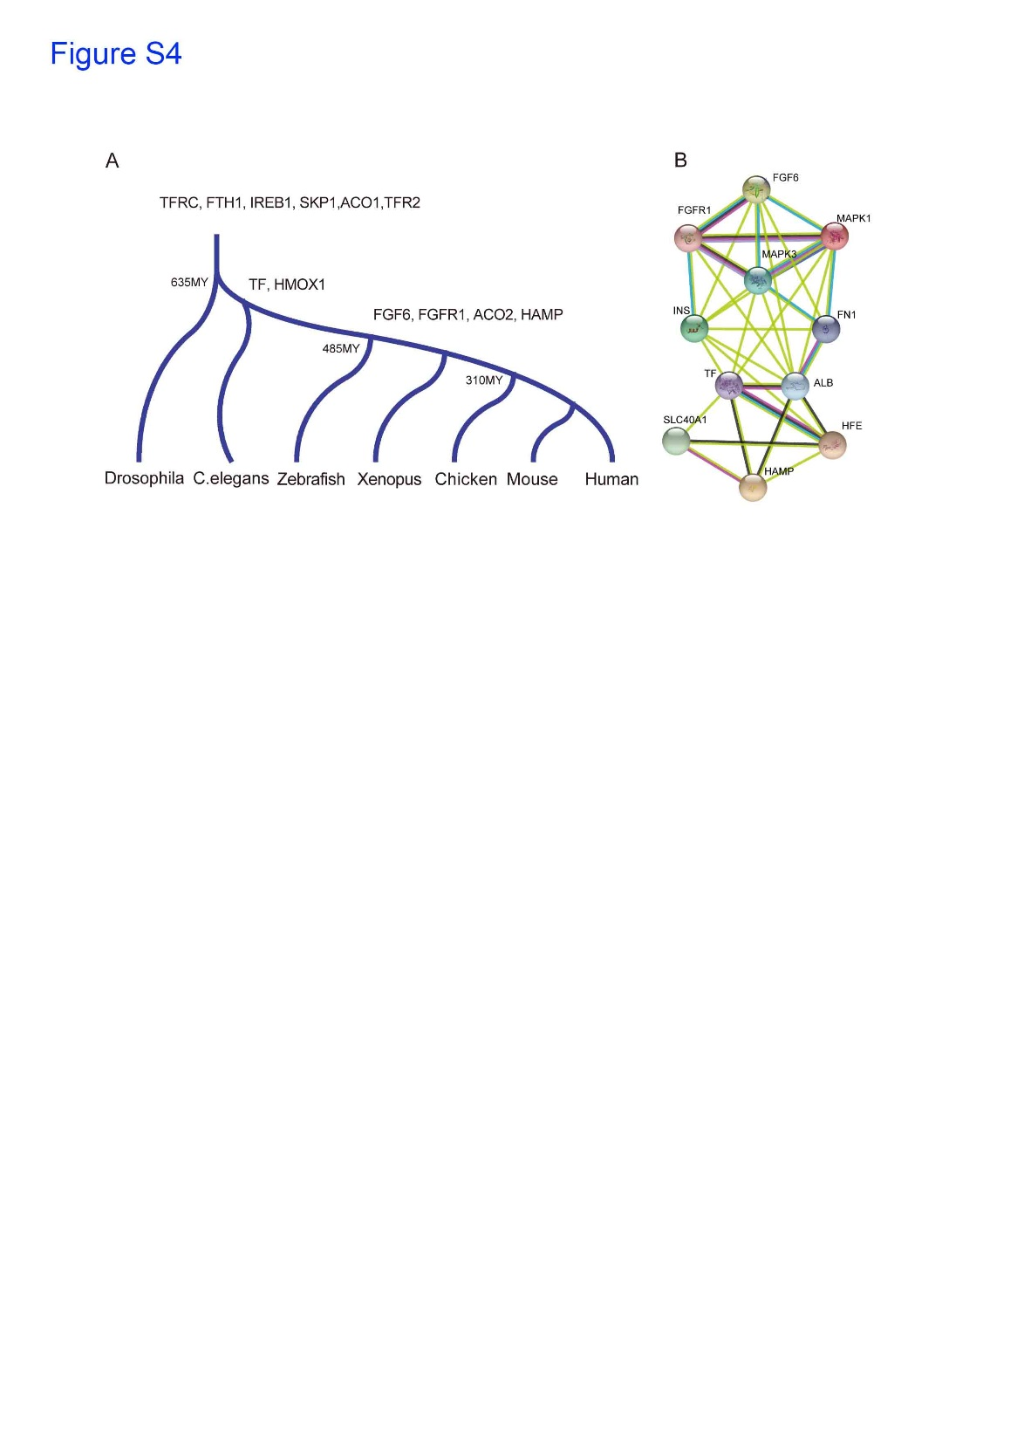
FGF6: molecular evolution and biological function
Encodes for the fibroblast growth factor 6 protein
Expressed across numerous tissues including skeletal muscle,
blood, liver and pancreas
Stage I: fundamental genes
Stage II: Regulatory Genes
Protein-protein interactions suggest
involvement of FGF-6 with Fe-metabolism
subnetwork

Slide 18
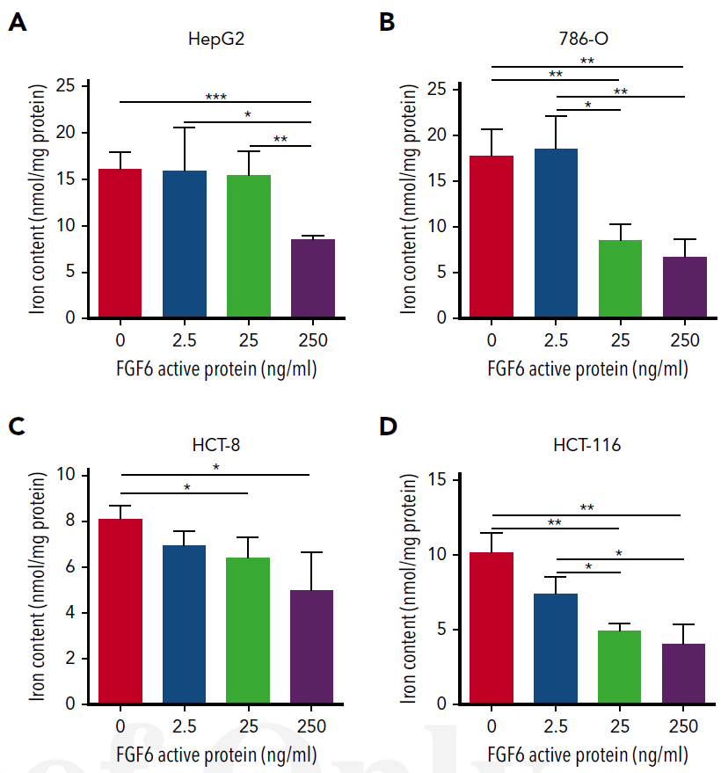
Dose-Dependent FGF-6 Impact on Intracellular Iron

Slide 19
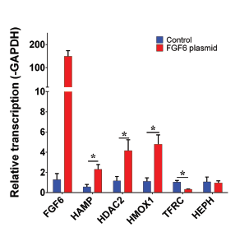
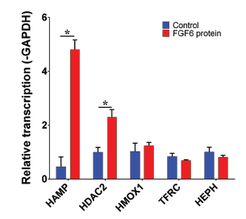
FGF-6 and FGF6 Transcriptional Regulation of Hepcidin (HAMP) in Hepatocytes
HAMP encodes for hepcidin
HDAC2 encodes for histone deacetylase 2
HMOX1 encodes for heme oxygenase 1
TFRC encodes for transferring receptor 1
HEPH encodes for hephaestin
Confirmed: FGF-6 could transcriptional regulate of Hepcidin (HAMP) in Hepatocytes
What is the biological Function of each variants?

Slide 20
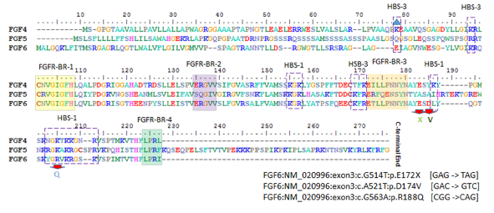
Evaluation of Three FGF6 Nonsynonymous Putative Functional Variants
Within or adjacent to heparin binding site motifs

Slide 21
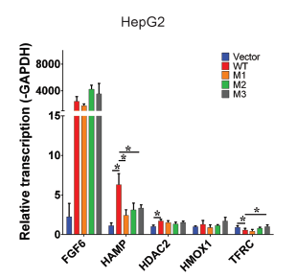
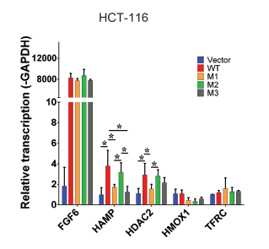
Variants Show Attenuation of Hepcidin Transcription Compared to Wildtype
M1: E172X
M2: D174V
M3: R188Q
Transfect FGF6 and variants into different cell lines

Slide 22
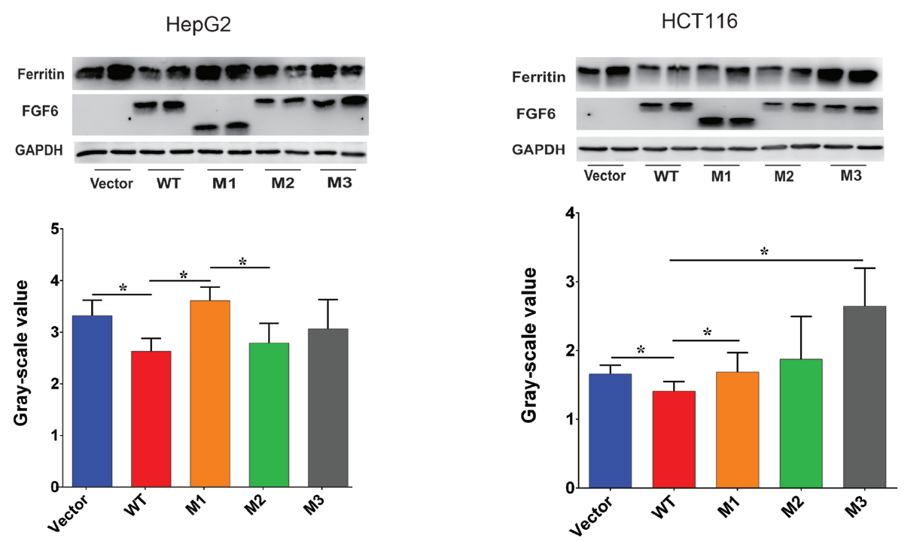
Variants Show Reduced Attenuation of Iron Uptake

Slide 23
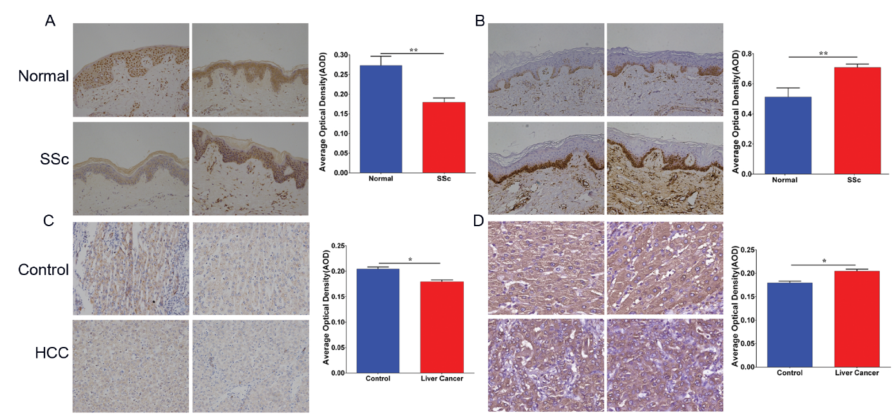
Low FGF6 expression and high iron deposition in liver cancer and systemic sclerosis (Immunohistochemistry, IHC)
FGF-6 protein level
Ferritin protein level

Slide 24
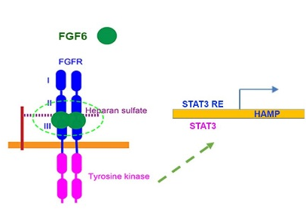
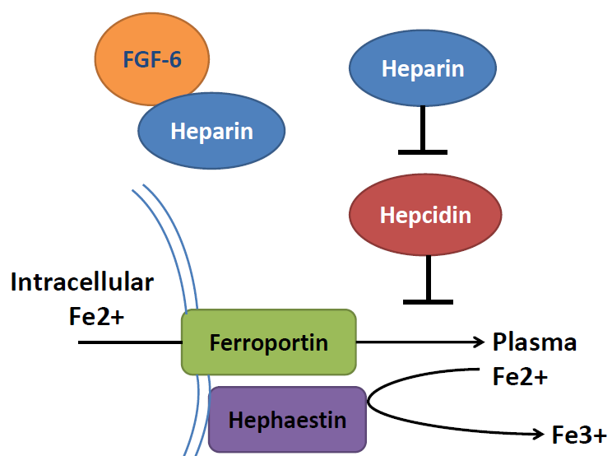
Marshfield Model: FGF6 decreases ferrous iron uptake in liver cells and induces increased hepcidin expression
Ferrous form
Ferric form

Slide 25
Marshfield Model: FGF6 decreases ferrous iron uptake in liver cells and induces increased hepcidin expression

Slide 26
Research contribution to clinical
 | Type 1 | Type 2A | Type 2B | Type 3 | Type 4
Name | Classic HHC | Juvenile HHC | Juvenile HHC | TfR2-related HHC | Ferroportin-related iron overload
Gene | HFE | HJV | HAMP | TfR2 | SLC40A1
Protein Produced | HFE | Hemojuvelin | Hepcidin | Transferrin receptor 2 | Ferroportin (iron regulatory protein)
Inheritance | autosomal recessive | autosomal recessive | autosomal recessive | autosomal recessive | autosomal dominant
Function | interruption of transferrin-bound iron, possible modulation of hepcidin regulation | unknown; possible hepcidin modulation | regulation of iron release in intestinal and blood cells | possible interference of iron uptake by liver cells | possible interference of iron export from intestinal, liver and placental cells
Organ Damage | variable | high | high | variable | low
Age of Onset | 40s or 50s | 20s or 30s | 20s or 30s | 40s or 50s | 40s or 50s
Type 5
FGF6-related iron overload
FGF6
Hepcidin and FGF6
CH recessive
?
?
?
1. Identified a new substype of hemochromatosis
2. More understanding to hemochromatosis
3, potential drug targets for the therapy of hemochromatosis

Slide 27







Acknowledgements
Brent Olson, MRCI
Terrie Kitchner, MCRI
Jeffrey Joyce, MCRI
Robert Strenn, MCRI
Joseph J. Mazza Steven Schrodi Jennifer K. Meece

Slide 28
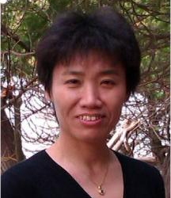
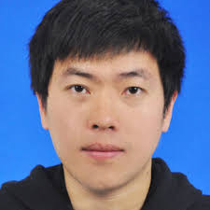


Acknowledgements
Prof. Jiucun Wang
Fudan University
Dr. Shuai Jiang
Fudan University
Dr. Naren Epperla
OSU
Assoc Prof. Judy Smith
UW-Madison

Slide 31
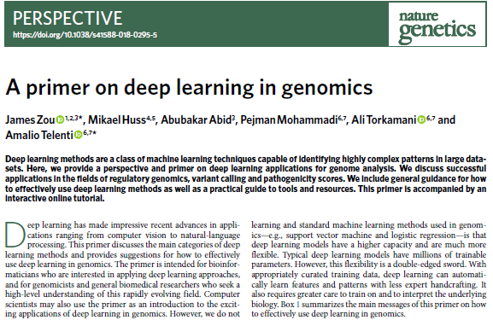
Neural Network based Deep Learning in Human Genetic Data
SRY and ATL1

Slide 32
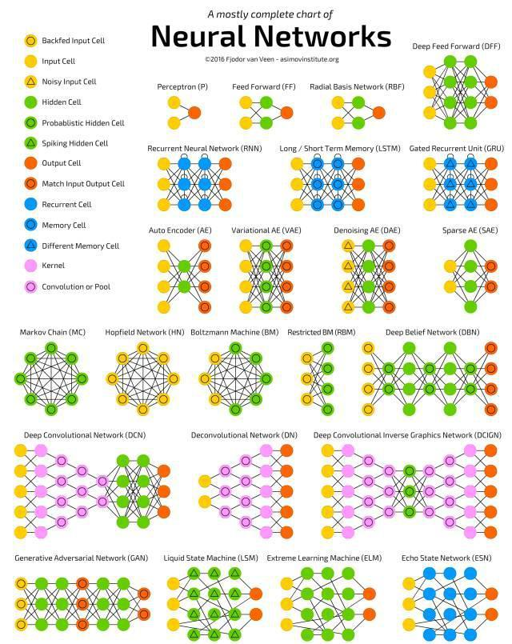

Slide 33
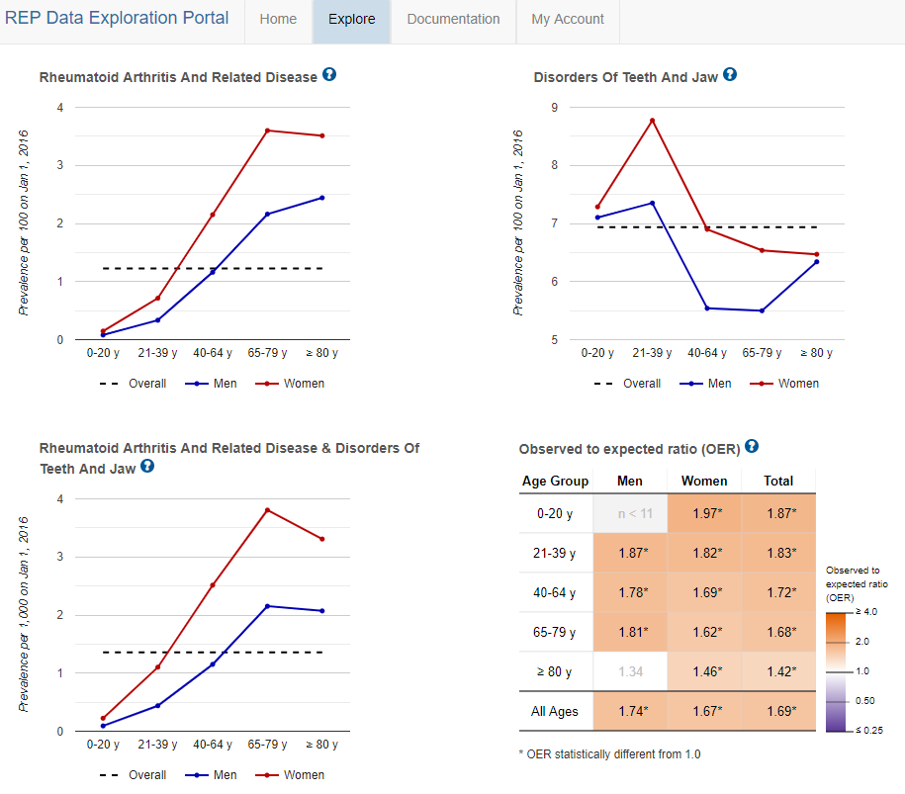
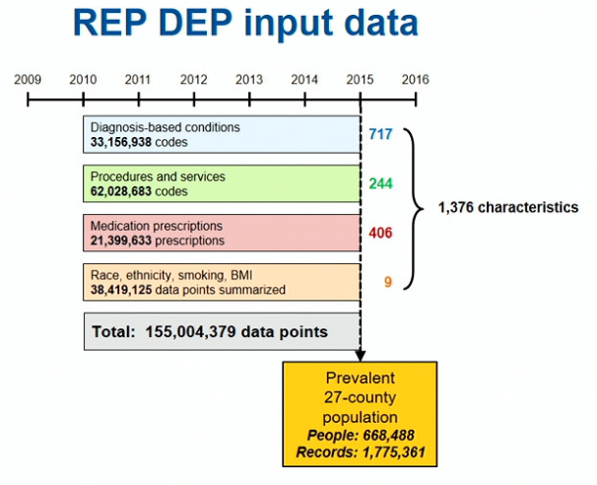
Rochester Epidemiology Project (REP)
MCRI Scientific Seminar: 02/08/2019
REP DEP from Mayo Clinic

Slide 34
Acknowledgements
Brent Olson, MRCI
Terrie Kitchner, MCRI
Jeffrey Joyce, MCRI
Robert Strenn, MCRI
Dr. Joseph J. Mazza Dr. Jennifer K. Meece
Dr. Naren Epperla, OSU
Dr. Judy Smith

Slide 35
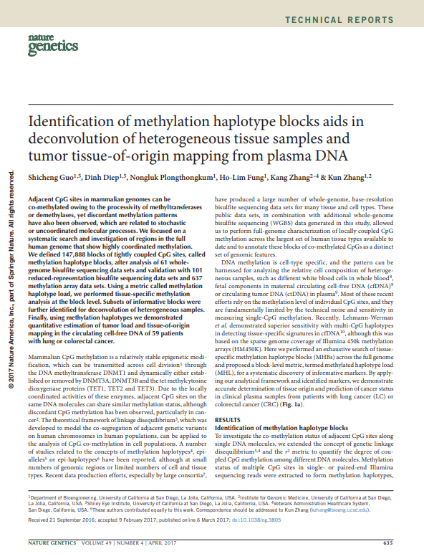

Slide 36
• 98% of patients have genetic variants that affect how well they do (or don’t) metabolize specific medications – or if the drug might have toxic effects¹ • 34% of all adverse drug reactions are caused by genetics, not drug-drug interactions²

Slide 37
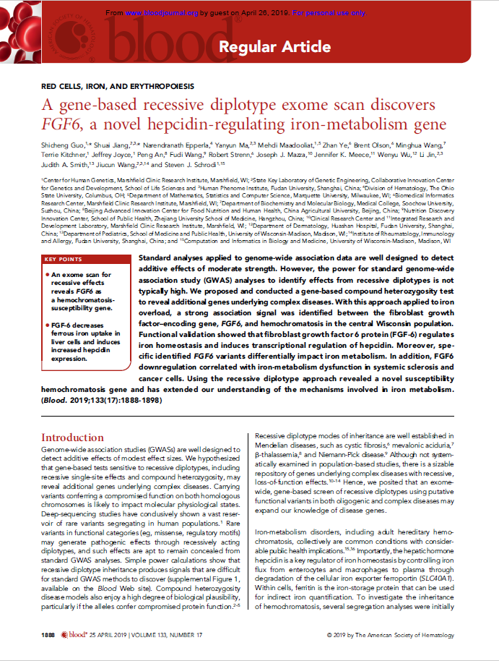

Slide 38
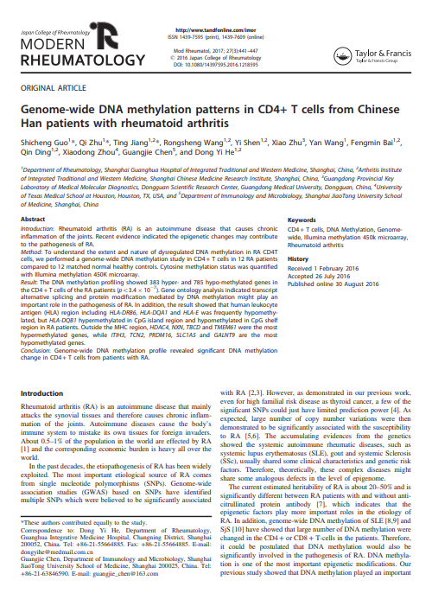

Slide 39
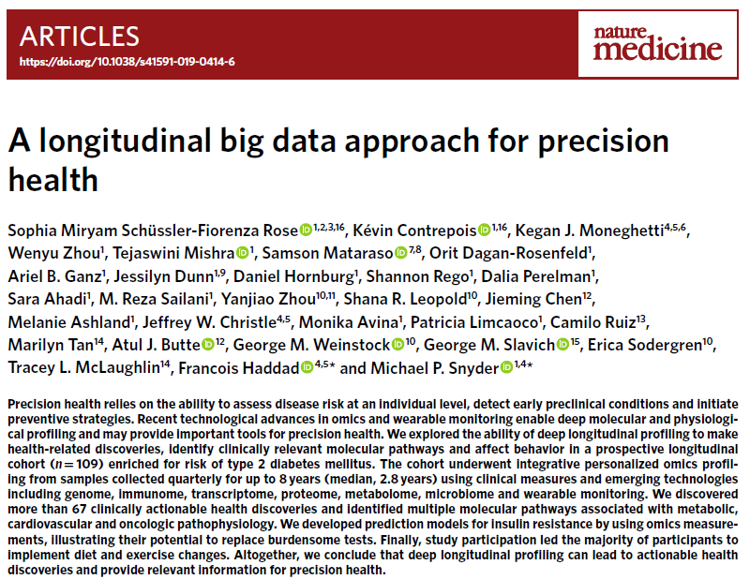
Precision medicine to common disease and rare disease
Published: 08 May 2019

Slide 40
How to Dismantle Obstacle on the Way to Precision Medicine
SNPs
CNV
Mutation
DNA methylation
RNA-seq
miRNA-seq
Bioinformatics
Clinical informatics
Image informatics
Pathology Informatics
Public health informatics
X-ray radiography
Magnetic resonance image
Notes:
Doing research is good, however, nobody want to take the risk to be the jail or life to do such research.

Slide 41
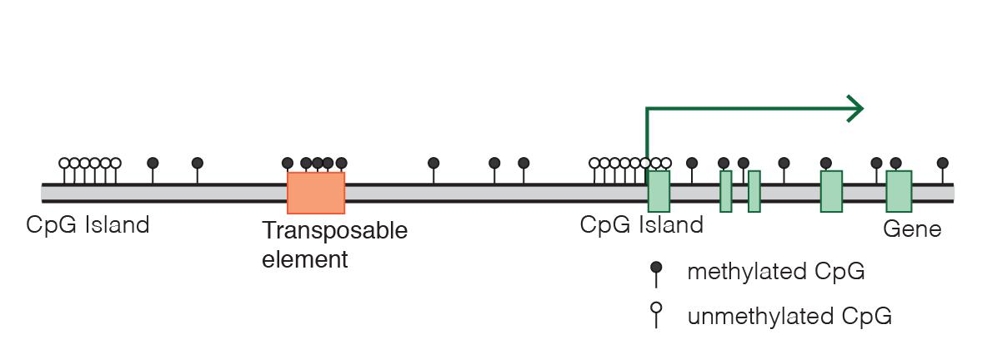
DNA methylation, gene expression and human development
DNA methylation, Wikipedia, 2019

Slide 42



Future work
US, FDA
US20070048738A1
Prostate cancer
Glioblastoma cancer
Pancreatic cancer
Chronic lymphocytic leukemia

Slide 43
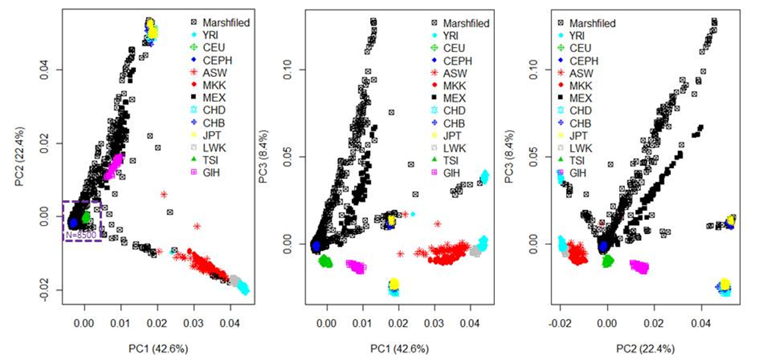

Slide 44
GSE103659: 181 GBM with 450K
GSE114534: 44 GBM with 450K
GSE66351: 190 normal brain with 450K
GSE41826: 58 normal brain with 450K
GSE89707: 142 normal brain with 450K
GSE74486: 131 brain from Trisomy 21 causes Down syndrome with 450K
GSE36194: 724 Normal brain with 27K
GSE53229 : 145 GBM with 27K
GSE50923: 54 GBM+23 control brain with 27K
GSE46015: 3 GBM, each sample have two replicates with 27K
GSE22867: 55 GBM + 3 normal with 27K
GSE119774: 39 GBM, 41 GSC, 9 NSC with 850K
GSE116298: 12 GBM, each sample have 3 replicates with 850K

Slide 45
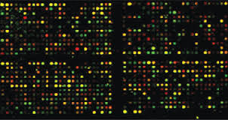
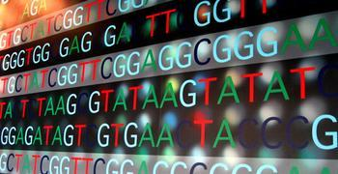
Low cost
High stability
Mature analysis
Low DNA requirement
Bigdata support
MethylCap-Seq
MBD-Seq
MeDIP-seq
RRBS
Bisulfite-Seq

Slide 46
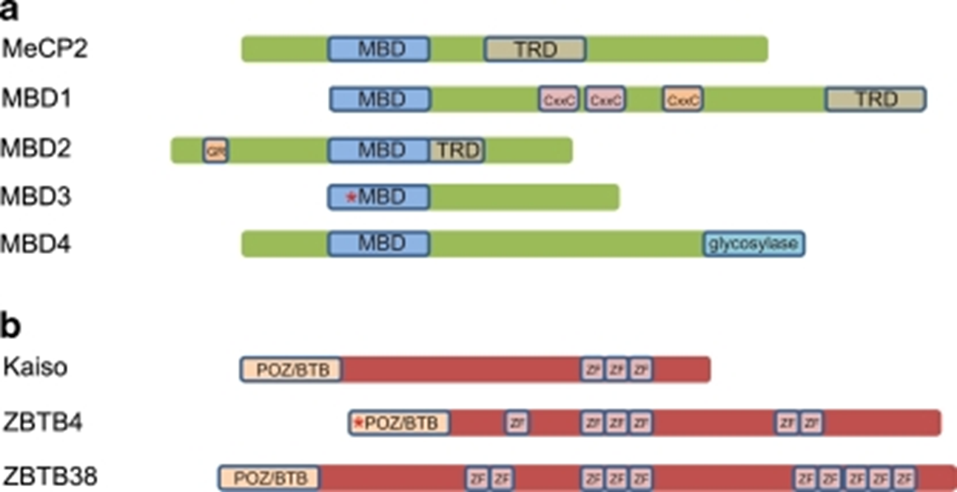
Two families of proteins that bind methylated DNA
Chromosoma. 2009 Oct; 118(5): 549–565
Notes:
Two families of proteins that bind methylated DNA. a Methyl-CpG binding proteins (MBDs): MBD proteins display homology within their MBD domains, while the transcription repression domains (TRD) described for MeCP2, MBD1, and MBD2 are non-homologous. In addition to its MBD domain, MBD1 is able to bind unmethylated DNA via its third CxxC zinc-finger motif. MBD2 features a characteristic stretch of glycine and arginine residues (GR) and has juxtaposed MBD and TRD domains. MBD3 is, due to a mutation in the MBD domain, not able to bind methylated CpGs in mammals. MBD4, a thymine glycosylase, contains a C-terminal glycosylase domain used for excision-based DNA repair. b Kaiso protein family: three members of the Kaiso protein family have been described so far. Kaiso, ZBTB4, and ZBTB38 share a triple zinc-finger domain and a BTB/POZ domain which in case of ZBTB4 contains a 60 amino acid insertion. Furthermore, ZBTB4 and ZBTB38 contain respectively three and seven additional zinc-fingers

Slide 47
Biochemical interactions of methyl CpG binding proteins
Protein | Interacting partner | Effects of the interaction | Reference
MeCP2 | Sin3A, HDACs | Transcriptional repression | Jones et al. (1998), Nan et al. (1998)
 | c-ski, N-CoR | Transcriptional repression | Kokura et al. (2001)
 | HMGB1 | Unknown | Dintilhac and Bernues (2002)
 | Sin3B, HDAC2 | Transcriptional repression | Rietveld et al. (2002)
 | Dnmt1 | Targeting of maintenance DNA methylation? | Kimura and Shiota (2003)
 | H3K9 methyltransferase | Transcriptional repression | Fuks et al. (2003b)
 | CoREST complex | Repression of neural genes | Ballas et al. (2005), Lunyak et al. (2002)
 | Brm (SWI/SNF complex) | Transcriptional repression | Harikrishnan et al. (2005), Hu et al. (2006)
 | YB-1 | Alternative splicing | Young et al. (2005)
 | ATRX | Epigenetic regulation required for neural development | Nan et al. (2007)
 | HP1 | Transcriptional repression during myogenic differentiation | Agarwal et al. (2007)
 | CREB1 | Transcriptional activation | Chahrour et al. (2008)
MBD1 | MPG | DNA repair | Watanabe et al. (2003)
 | Suv39h1-HP1 | Transcriptional repression | Fujita et al. (2003)
 | MCAF1, MCAF2, SETDB1, CAF-1 p150 | Transcriptional repressioinheritance of epigenetic states | Ichimura et al. (2005), Reese et al. (2003), Sarraf and Stancheva (2004)
 | PML-RARα, HDAC3 | PML-RARα-mediated silencing | Villa et al. (2006)
MBD2 | Mi-2, MTA1-3, P66α/β, HDAC1/2, RbAp46/48, DOC-1, PRMT5, MEP50 (NuRD complex) | Transcriptional repression | Brackertz et al. (2002), Le Guezennec et al. (2006), Zhang et al. (1999)
 | Sin3A | Transcriptional repression | Boeke et al. (2000)
 | Tax | Transcriptional activation | Ego et al. (2005)
 | TACC3, HATs, pCAF | Transcriptional activation | Angrisano et al. (2006)
 | GCNF | Oct-4 silencing | Gu et al. (2006)
 | Dnmt1 | Targeting of maintenance DNA methylation? | Tatematsu et al. (2000)
 | RFP | Enhancement of transcriptional repression | Fukushige et al. (2006)
MBD3 | Mi-2, MTA1-3, P66α/β, HDAC1/2, RbAp46/48, DOC-1 (NuRD complex) | Transcriptional repression | Le Guezennec et al. (2006), Wade et al. (1999), Zhang et al. (1999)
 | Dnmt1 | Targeting of maintenance DNA methylation? | Tatematsu et al. (2000)
 | CDK2AP1, GCNF | Oct-4 silencing | Deshpande et al. (2009), Gu et al. (2006)
MBD4 | Sin3A, HDAC1 | Transcriptional repression | Kondo et al. (2005)
 | FADD | Genome surveillance/apoptosis? | Screaton et al. (2003)
 | MLH1 | DNA repair | Bellacosa et al. (1999)
 | RFP | Enhancement of transcriptional repression | Fukushige et al. (2006)
Kaiso | Tcf3 | Suppression of Wnt signaling | Ruzov et al. (2009)
 | p120 | Wnt signaling? | Daniel and Reynolds (1999), Prokhortchouk et al. (2001)
 | N-CoR | Transcriptional repression | Yoon et al. (2003)
Chromosoma. 2009 Oct; 118(5): 549–565
Notes:
Chromosoma. 2009 Oct; 118(5): 549–565.

